Slide 1

Music Recommender
Marko Znamenaček

Slide 2
Goal and hypothesis
Goal: The problem that the music recommender project aims to address is the overwhelming amount of music available to listeners
Hypothesis: Users who receive personalized music recommendations based on their listening habits and preferences will be more likely to engage with the music streaming platform
I expect to get good recommendations that I will grade myself

Slide 3
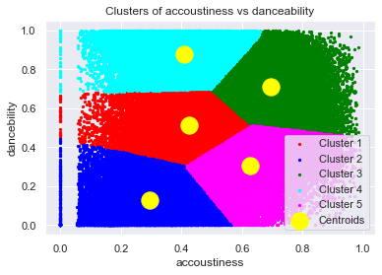
Approach, methods, and techniques
First step: Finding the dataset
Second step: Cleaning the dataset
Third step: Plotting all the data
Fourth step: Clustering the data using Elbow method and K-Means
Fifth step: Building the recommender

Slide 4
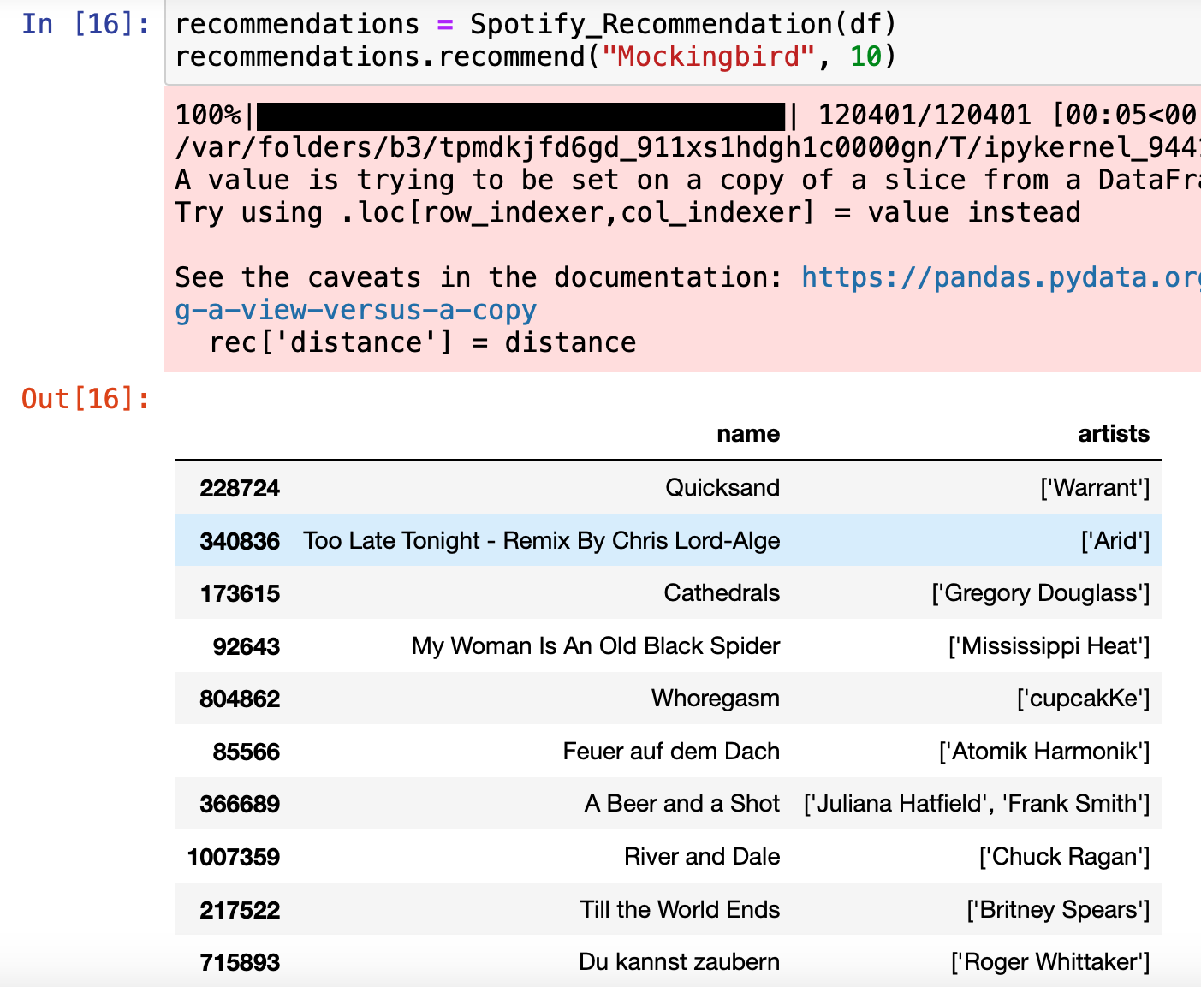
Results and conclusions
Unhappy with results, I was not happy with the music that was recommended to me
Hard to estimate what one would like based on one song entered
Probably need to consider much more than one songs characteristics

Slide 5
Literature
Kaggle. (n.d.). Spotify 12M songs. Retrieved March 19, 2023, from https://www.kaggle.com/datasets/rodolfofigueroa/spotify-12m-songs?resource=download
Ravi Prakash. (n.d.). MusicRecommendationSystem. GitHub. Retrieved March 19, 2023, from https://github.com/raviprakash11/MusicRecommendationSystem
Tomar, A. (2022, November 17). Stop using elbow method in k-means clustering, instead, use this! Towards Data Science, https://towardsdatascience.com/elbow-method-is-not-sufficient-to-find-best-k-in-k-means-clustering-fc820da0631d
Mavani, V. (2020, October 29). Music recommendation system using Spotify dataset. Kaggle. https://www.kaggle.com/code/vatsalmavani/music-recommendation-system-using-spotify-dataset
The Clever Programmer. (2021, March 3). Spotify recommendation system with machine learning. https://thecleverprogrammer.com/2021/03/03/spotify-recommendation-system-with-machine-learning

Slide 6
Thanks for listening

